Slide 1
Red Hat & Cisco
Accelerating Data Center Modernization with Ansible & ACI
John Welby
Senior Solutions Architect, Cisco NA Alliance
Eric Blaufarb
Client Executive,
Cisco NA Alliance

Slide 2
Agenda
Introduction – Red Hat & Cisco Sales Partnership
Ansible Automation Platform
Ansible Cisco Network Automation – solving crucial customer problems
How to Setup Your Ansible Automation Demos
Ansible + ACI - demonstration
Next Steps & Contacts

Slide 3
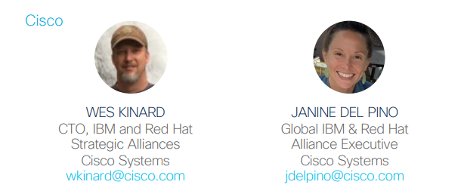

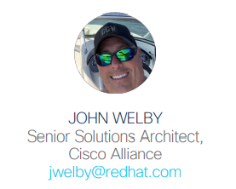
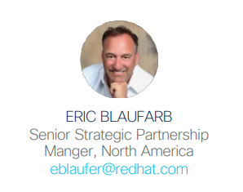
The Team

Slide 4
Cisco & Red Hat Introduction
Eric Blaufarb & Janine Delpino

Slide 5

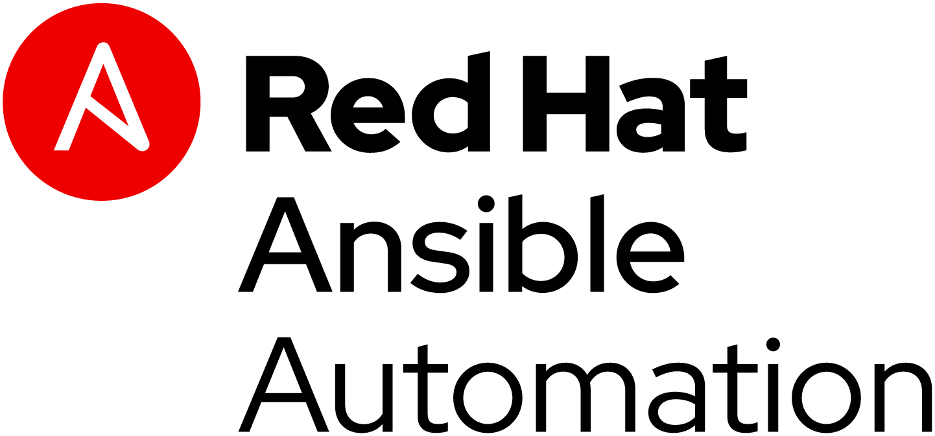




Business Value
Cisco is the leading provider of enterprise networking, compute, and storage.
ACI/MSO/Intersight is the multi-cloud solution providing the fabric and tools that simplify the management for multi-cloud.
Cisco’s Intersight simplifies public and private cloud management to extend customers' IT infrastructure to the cloud.
Cisco’s UCS solutions combine compute, networking, and storage, into tested and certified solutions.
The complete scope of a private cloud is enabled with Cisco and Red Hat’s complimentary product portfolios, to deliver private and multi-cloud deployment and management capabilities. Our joint solutions offer consolidated management, orchestration, and monitoring for mission-critical workloads. ACI integration with Ansible & OpenShift delivers network and workload automation and orchestration from the data center to edge.
Joint Solutions
Network Fabric and Hybrid Cloud Infrastructure with OpenShift options on Red Hat Virtualization or OpenStack
Cisco validated designs for Network & workload Management OpenShift, Ansible, RHEL, RHEV, OPS, CEPH on Cisco UCS
ACI integrations Simplify Network & Container Management
Ansible Content. Cisco Validated Designs & Playbooks with Ansible modules
Product Certifications
Partnership Highlights
Partnership Highlights
The Red Hat Global Alliance Team at Cisco
Increased strategic focus on Red Hat / IBM / Cisco joint technology roadmap
Implemented Sales engagement model with optics into joint customer wins
Overall Greater partner advocacy and organizational alignment

Slide 6
What can Cisco offer Red Hat?
Full Stack Solution
Cisco validated designs with Red Hat technologies such as RHEL and OpenShift, leveraging low risk deployments
Drive out Dell/VMware with alternative end to end hybrid cloud infrastructure solution
Access to Cisco install base
Large install base across all architectures
Access to different buying centers
Deeper customer engagement
Provide further penetration into existing accounts across teams
Provide larger scale joint solutions via teaming
Cisco channel
Strong channel business to create and support joint solutions
Cisco is close to 100% Channel business

Slide 7
What can Red Hat offer Cisco?
VMware compete
Help compete against Dell/VMware control point in the data center
Better together story
DevOps conversation
Containers are the new conversation around Data centers and Hybrid Cloud
Access to different buying centers
Enhance Cisco Technology
Provide further capability to customers with our complimentary solutions (e.g.. Ansible and ACI integration)
Leverage IBM partnership
IBM is slowly migrating its customers to OpenShift with their Cloud Paks.
IBM PCaaS is providing an integrated Cisco-RH stack based on UCS and OpenShift

Slide 8
Better Together
Cisco & Red Hat
Wes Kinard & John Welby

Slide 9

Introduction: Ansible + ACI Solution
ACI is both powerful and flexible but it can also be very complex.
Reducing the number of manual tasks that must be performed provides customers with a reduction in configuration errors, inconsistency, time spent, and the number of highly skilled network engineers required.
Red Hat Ansible is one of the most popular automation tools being used to simplify routine networking tasks and Cisco has invested significantly in Ansible modules for ACI.
Organizational transformation
Adopting automation is transformational to IT
Ansible and ACI are better together ACI automation demonstration
https://github.com/johnwelby1965/cisco_aci.git
Notes:
The features and capabilities ACI enables in regards to policy-driven fabric and services automation from an application-centric perspective are paramount. Automating the configuration of resources with a detailed focus on the requirements of the application greatly changes the overall paradigm of infrastructure provisioning. With such policy-driven automation at the fingertips of IT, one may question the need for other automation and orchestration tools. While ACI provides superior fabric and services automation through policy, there are other aspects of infrastructure that are required for applications to properly exist and perform, which are outside the scope of ACI and APIC. Resources such as storage, virtual machines, physical servers and other endpoints are still very important to applications, however are not automated and configured through ACI or APIC policy. It is the automation of these other infrastructure resources or endpoints, as well as the aspect of tying all automation together into a single automation process, where Red Hat Ansible Automation Hub (i.e. Ansible Tower) provides incredible value to IT. Ansible Tower is an automation and orchestration platform with a broad scope of support including both Cisco and non-Cisco infrastructure components across ACI/APIC, storage, virtual machines, physical servers and more, creating a complete and comprehensive end-to-end application infrastructure automation solution

Slide 10
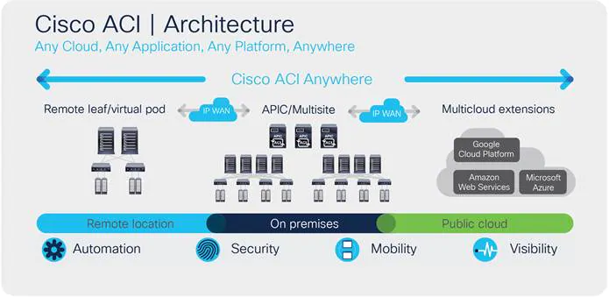
Why ACI is Important
Delivers intent-based networking
Next generation software-defined data center
Policy driven programmable fabric
Dynamic provisioning of services: network, security & infrastructure
Notes:
ACI Fabric Discovery – uses Intra-Fabric Messaging (IFM) Process
* APIC and nodes exchange heartbeat messages
* APIC uses an IFM Process to push policy to fabric leaf nodes
Three Stages: (1) Leaf directly connected to APIC is discovered (2) Spines connected to (above) leaf are discovered (3) other leaf nodes and other APICs are discovered
LLDP Neighbor Discovery
Tunnel Endpoint (TEP) assignment via DHCP
ISIS adjacency mode
Certification Validation
Start of DME Process on switches
Tunnel Setup (iVxlan)
Policy Element IFM Setup

Slide 11
Why Ansible is Important
Ansible release (2.10), there are over 100 ACI and Multisite modules
Enables admins to align on a unified approach to managing ACI the same way they manage other data center and cloud infrastructure.
ACI Ansible modules provide broad coverage for many ACI objects
ACI Ansible modules are idempotent ensuring that playbook results are always the same
ACI Ansible modules extend the trusted secure interaction of the ACI CLI and GUI.
No programming skills required with Ansible module
Higher adoption, faster implementation with fewer errors

Slide 12
Types of Ansible ACI Modules
Tenant modules - used to manage Tenant configurations, including App Profiles, EPGs, VRFs, Bridge Domains, and Policy configurations.
Infrastructure modules - used to interact with the Fabric Inventory and Switchport Policies.
Configuration Management - the package currently supports creating configuration snapshots, previewing configuration differences, and performing a rollback to a previous snapshot.
General Purpose module(s) - used for any feature that doesn't yet have a module. A general purpose module that can be used to make any request to the API using data stored in a JSON or XML file.
Higher adoption, faster implementation with fewer errors

Slide 13
ACI Explained

Slide 14
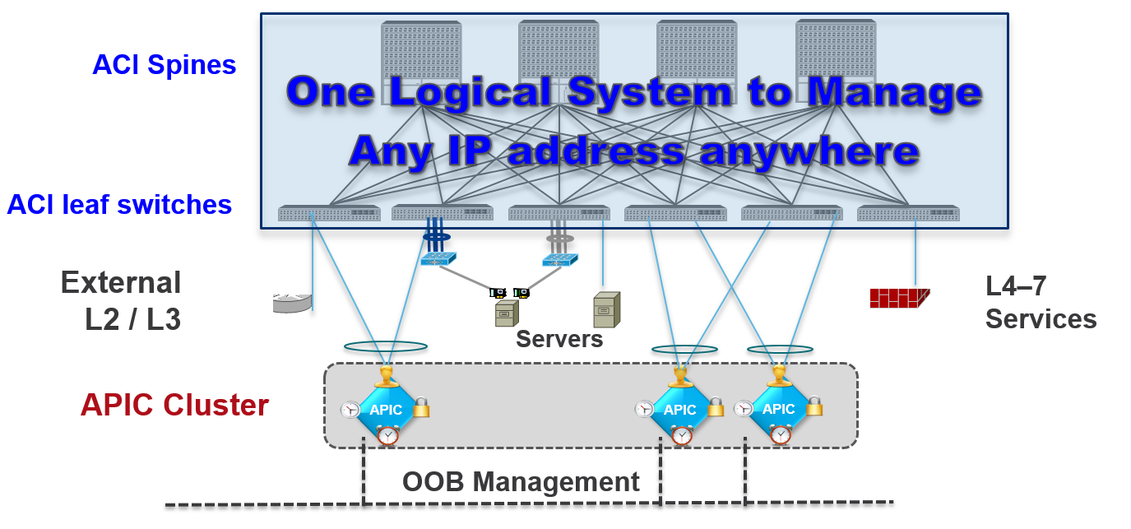
Deeper Dive into ACI
The Nexus switches running in ACI mode are only programmable via an object-based Policy Engine operating in the APIC controller. The controller is integrated part of the network and holds profiles containing the policies for programming the switches centrally. The switches themselves do not maintain a CLI configuration file as previously used in NX-OS based systems.
The configuration is held on the APIC using an object-oriented schema. It is represented with either XML or JSON and stored in a profile to implement application-driven, network-driven, and security-driven policies.

Slide 15
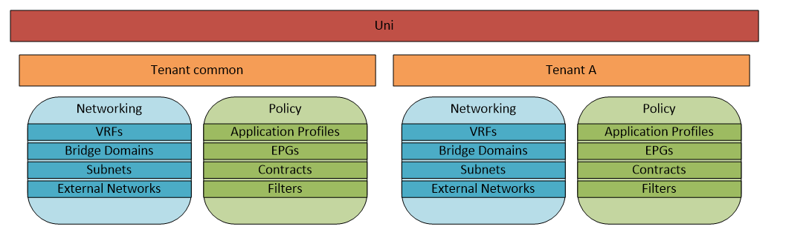
ACI - Tenants
Tenants are a top level object that identify and separate administrative control, network/failure domains, and application policies.
ACI has a special Tenant named "common" that has unique abilities to easily share its resources with other Tenants. The "common" Tenant is designed to provide shared resources to the entire ACI fabric, such as DNS, authentication services, security tools, and others. You can also define all of the Tenant Networking objects, Contracts, and Filters in the "common" Tenant and associate these with Applications in other Tenants.

Slide 16
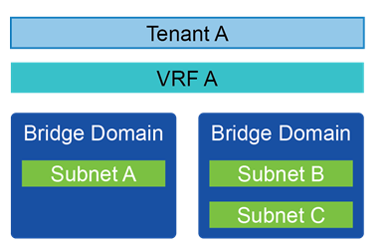
ACI - Tenant Networking
Tenant Networking consists of VRFs (Virtual Routing and Forwarding), Bridge Domains, Subnets, and External Networks.
VRFs, also named Contexts and Private Networks, are isolated routing tables for the Tenant. A Tenant can have one or many VRFs, or could use a VRF from the "common" Tenant. In the following diagram, the infra VRF is in the grey area. All additional VRFs exist on any leaf that has a host assigned to the VRF.
Bridge Domains are the Layer 2 forwarding domains within the fabric, and define the unique MAC address space and flooding domain (Broadcast, Unknown Unicast, and Multicast). Each Bridge Domain is associated with only one VRF, however a VRF can be associated with many Bridge Domains. Unlike the way VLANs have been traditionally deployed, each Bridge Domain can contain multiple subnets.
Subnets are the Layer 3 networks that provide IP space and gateway services for hosts to connect to the network. Each subnet is associated with only one Bridge Domain.
External Bridged Networks connect a Layer 2/Spanning-Tree Network to the ACI fabric. This is commonly used in brownfield environments to have a smooth migration from a traditional network infrastructure to an ACI network. The following diagram also has Layer 2 External networks for L4-L7 devices.
External Routed Networks create a Layer 3 adjacency with a network outside of the ACI fabric. Layer 3 External networks support adjacencies using static routes or BGP, OSPF, and EIGRP. Layer 3 connections also have networks defined, which provide and consume contracts (discussed more in Tenant Policy).

Slide 17
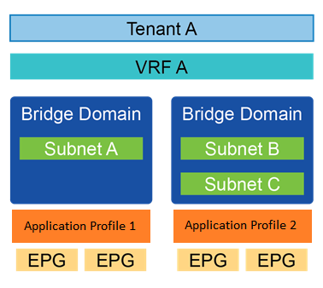
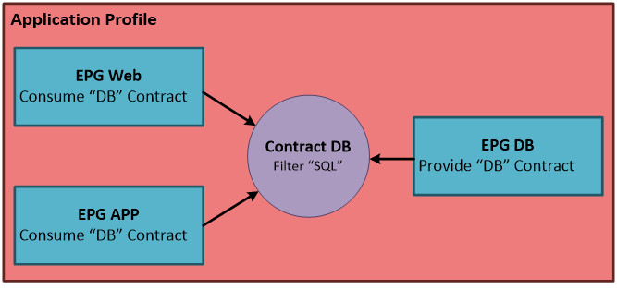
ACI – Tenant Policy
An Application Profile is a container for End Point Groups (EPGs). The Application Profile
is used as an identifier for Applications, and allows for separation of administrative privileges.
An End Point Group (EPG) is a collection of endpoints that have the same services
and policies applied. EPGs define the switchports, virtual switches, and Layer 2
encapsulations associated with an application service. Each EPG can only be related
to one Bridge Domain.
Contracts define the services and policies applied to the end points in an EPG. Contracts
can be used for service redirection to an L4-L7 device, assigning QoS values, and applying
ACL rules. The EPG that offers the services provides the contract, and the EPGs that need
to use the service consume the contract.
Filters are the objects that define protocols (tcp, udp, icmp, and so on) and ports. Filter objects can contain multiple protocols and ports, and Contracts can consume multiple Filters.

Slide 18
Different “Flavors” of Ansible

Slide 19
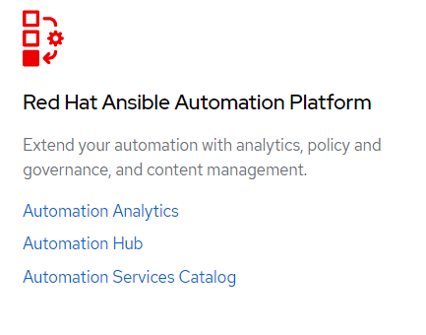
Red Hat Ansible Tower vs. Ansible Engine
Role-based access control: set up teams and users. LDAP/AD integration
Job scheduling: schedule jobs and set repetition options
Fully documented REST API: integrate Ansible into existing toolset and environment
Tower Dashboard: quickly view a summary of entire environment
Service Catalogs
Ansible Automation Analytics
Automation Hub
Cloud integration: compatible with the major cloud environments: Amazon EC2, Rackspace, Azure.
Notes:
Ansible Tower is not branded Ansible Automation Hub.
Engine is the upstream.

Slide 20
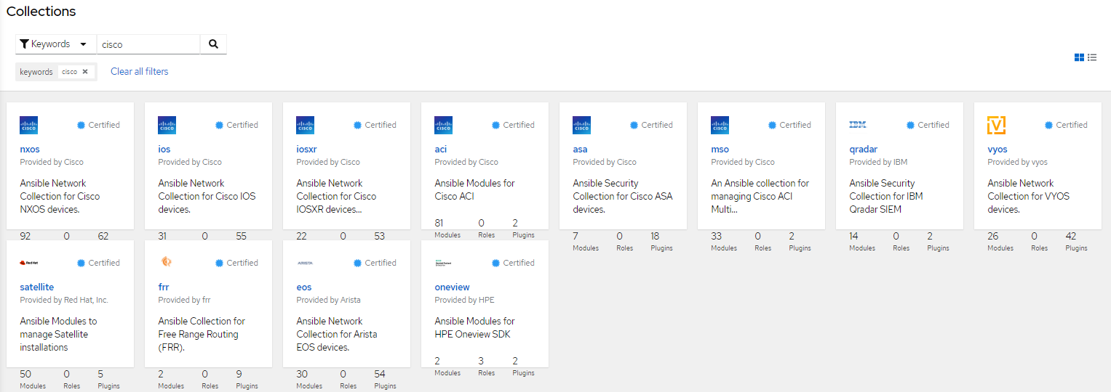
Red Hat Ansible Automation Platform Automation Hub – Collections
https://cloud.redhat.com/ansible/automation-hub/?page_size=12&view_type=null&keywords=cisco

Slide 21
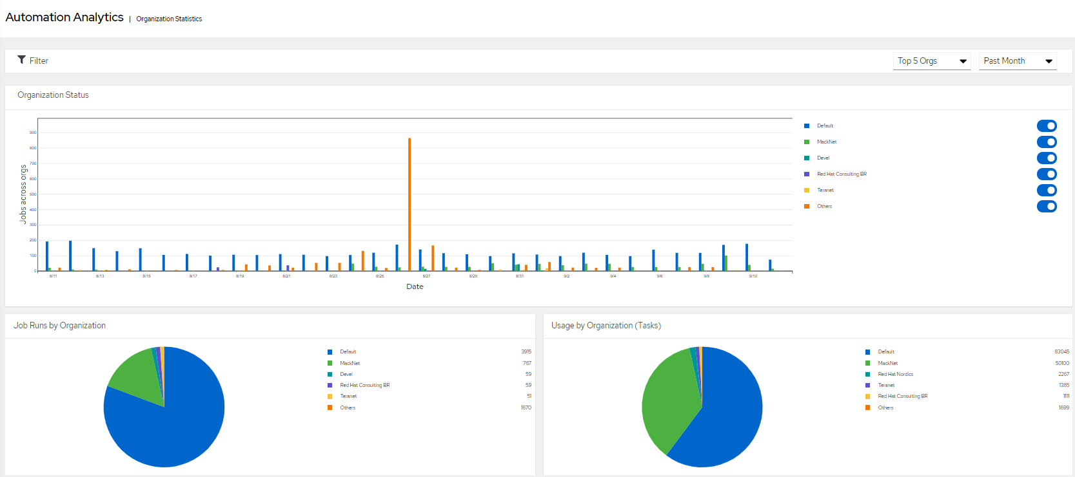
Red Hat Ansible Automation Platform – Job Runs, Usage by Organization, Template Usage
https://cloud.redhat.com/ansible/organization-statistics
Notes:
Ansible Tower is not branded Ansible Automation Hub.
Engine is the upstream.

Slide 22
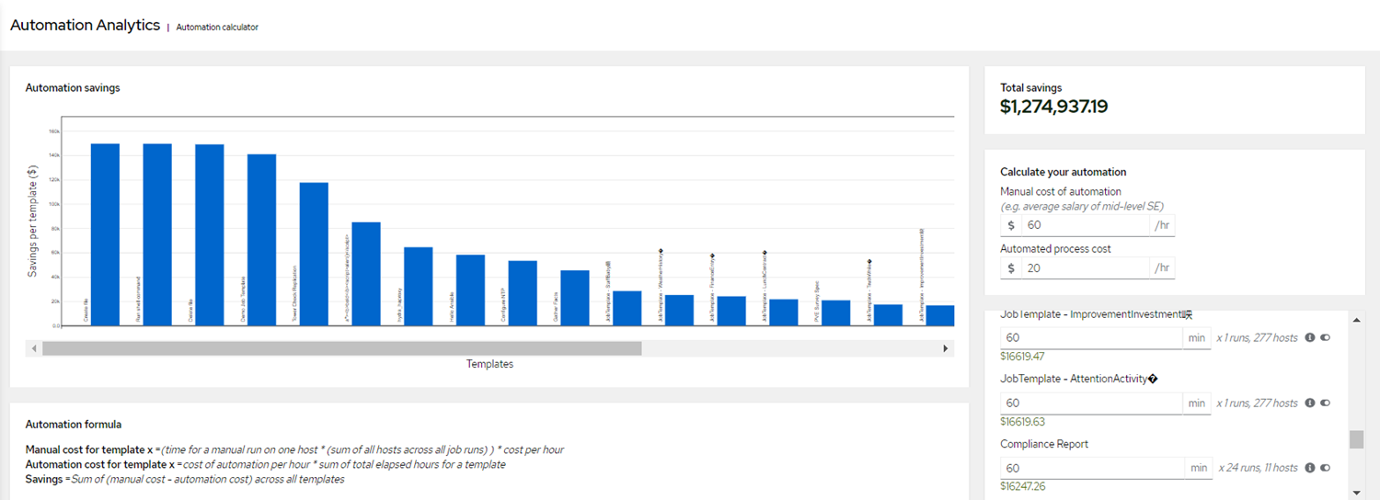
Red Hat Ansible Automation Platform Automation Analytics – Automation Calculator
https://cloud.redhat.com/ansible/automation-calculator
Notes:
Ansible Tower is not branded Ansible Automation Hub.
Engine is the upstream.

Slide 23
Ansible Competitive Advantages

Slide 24
Ansible Competitive Advantages
Ansible is the language of IT infrastructure. Ansible works on all infrastructure from on premise to cloud based hosts. Networking infrastructure is important to Ansible and we support more networking platforms and Ansible has a much larger community and following.
Ansible uses industry standard and open source Jinja2 for templating. This allows a wealth of education materials, online examples, books and more. Jinja2 is commonly used in products outside Ansible like Flask and in large companies like Instagram, Mozilla and NPR. Source: http://jinja.pocoo.org/
Ansible supports all infrastructure from on premise to cloud based hosts.
Ansible’s ease of use makes it quickly adoptable for both green and brown field deployments. Anything with an SSH connection can be automated.
Agentless and low learning curve means it can be used in more practical applications (like networking) and become the standard language across all infrastructure.
Enterprise Support. Ansible is a product, an offering such as NAPALM, is a project.
Notes:
Ansible Tower is not branded Ansible Automation Hub.
Engine is the upstream.

Slide 25
Ansible Use Cases

Slide 26
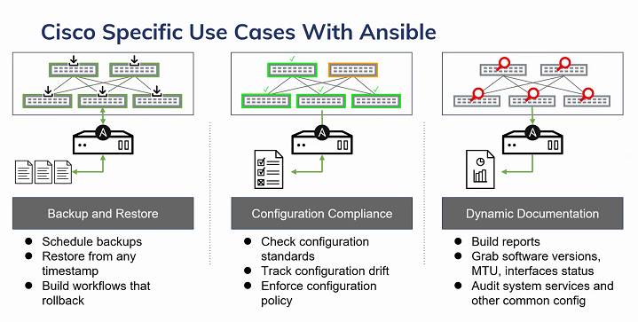
Ansible Use Cases

Slide 27
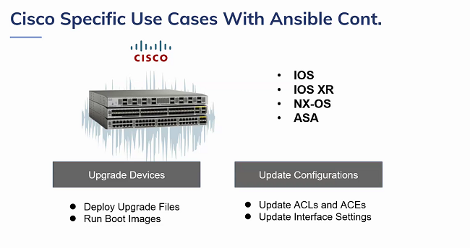
Ansible Use Cases

Slide 28
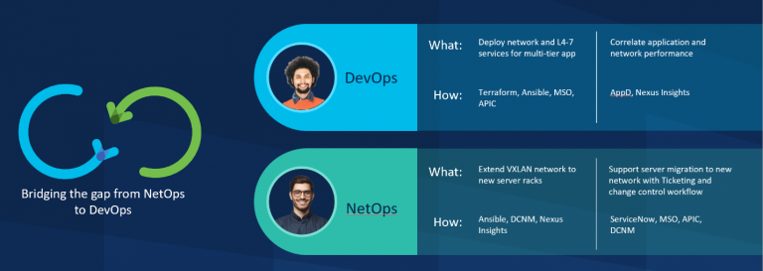
Ansible Use Cases – Ansible & Cisco Nexus Dashboard
DevOps can leverage an Infrastructure as Code approach to link Ansible services with the MSO API.
https://github.com/datacenter/Ansible-NXOS
Notes:
NetOps teams can integrate directly with ServiceNow to generate tickets for centralized incident management.
DevOps teams can map application, network and compute context by linking Nexus Insights with Cisco AppDynamics and Cisco Intersight, providing rich contextual information that enables DevOps to monitor application performance, identify network bottlenecks affecting applications, and fine-tune workloads accordingly.

Slide 29




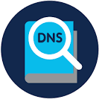
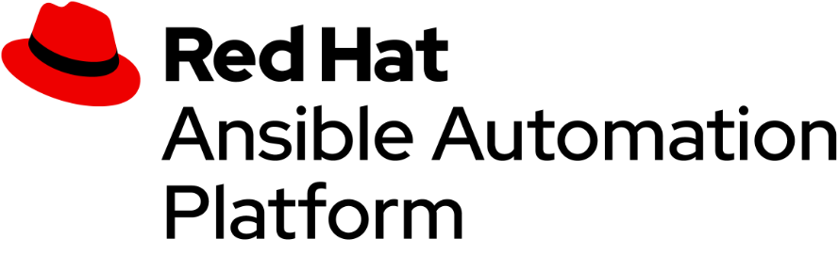


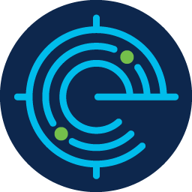

Automating Cisco Solutions with Ansible – Cisco & Red Hat Better Together
Designed to orchestrate management across domains and product platforms
Expansion of Ansible as the enterprise automation platform
Integrates & orchestrates multiple classes of network management solutions
Provides modules, roles and playbooks to support use cases across those solutions
FirePower Next-Gen IPS/IDS
ASA Next-Gen Firewalls
DNA Center
Telehealth
Umbrella
Intersight
vManage
Tetration
Notes:
Cloud workload protection
Automate micro-segmentation and gain better threat detection and protection with Cisco Tetration.
Automate security policy push using Ansible playbook
Every network device is a sensor -- devices send telemetry data to collector

Slide 30
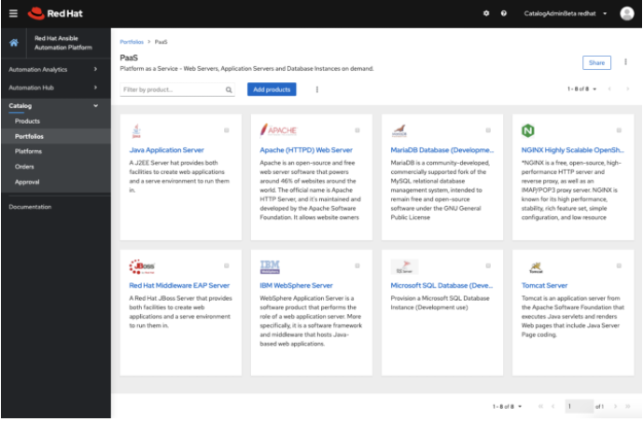



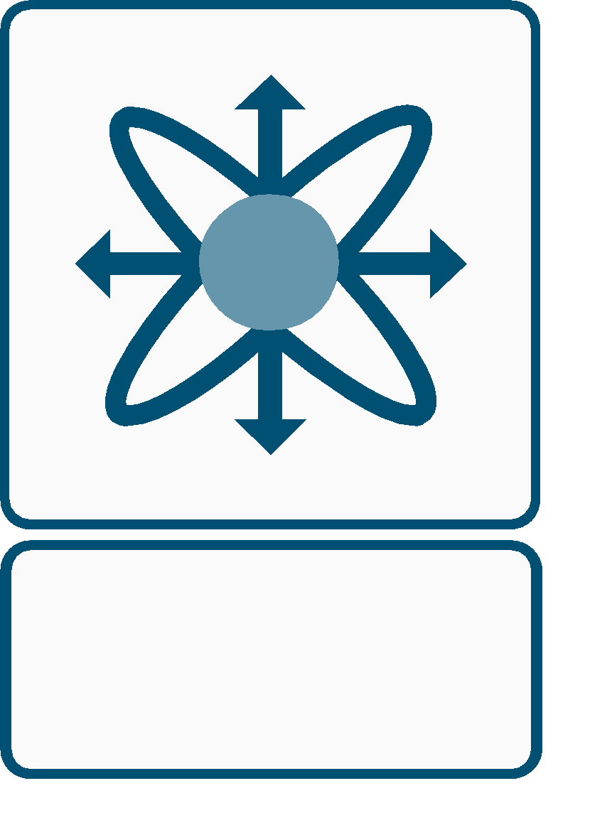
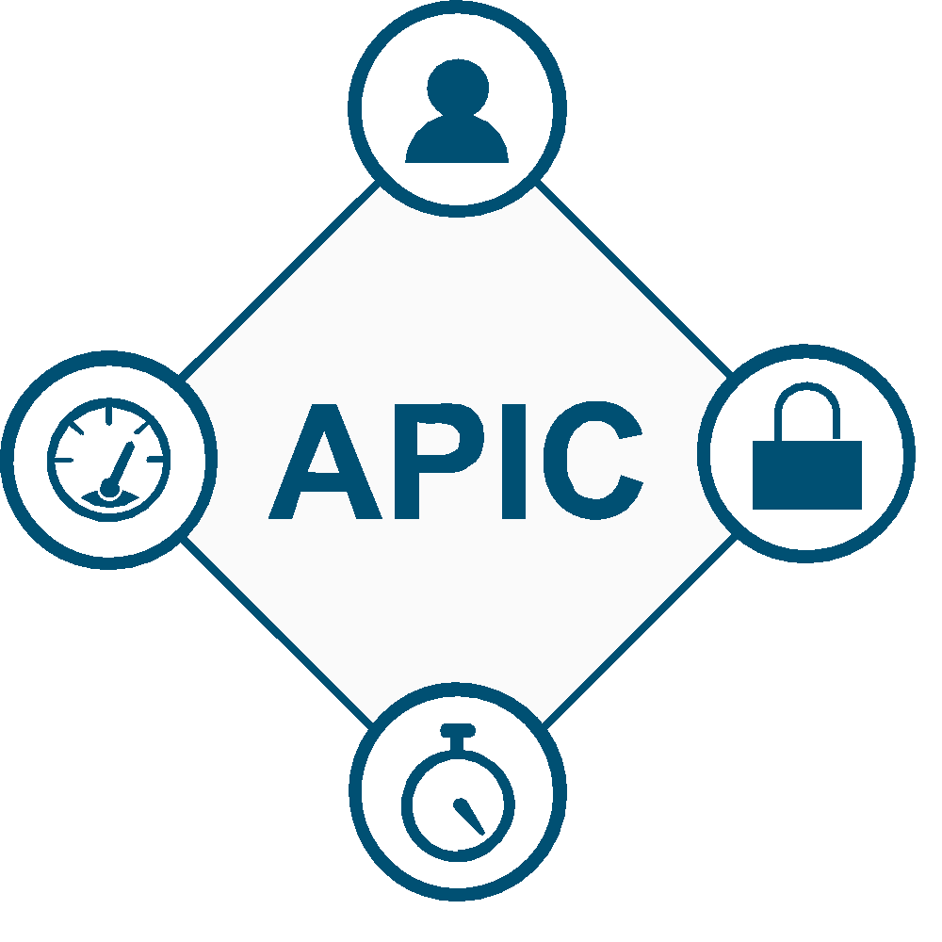
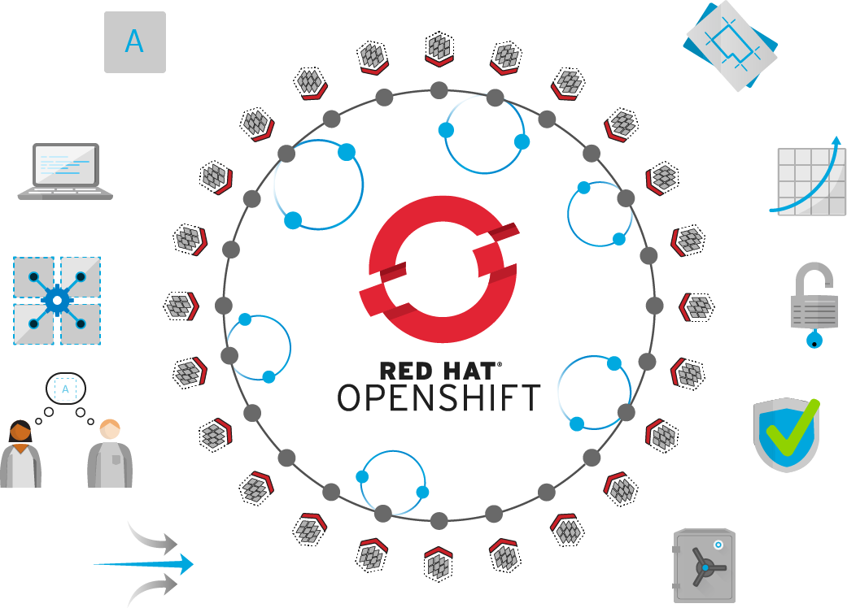

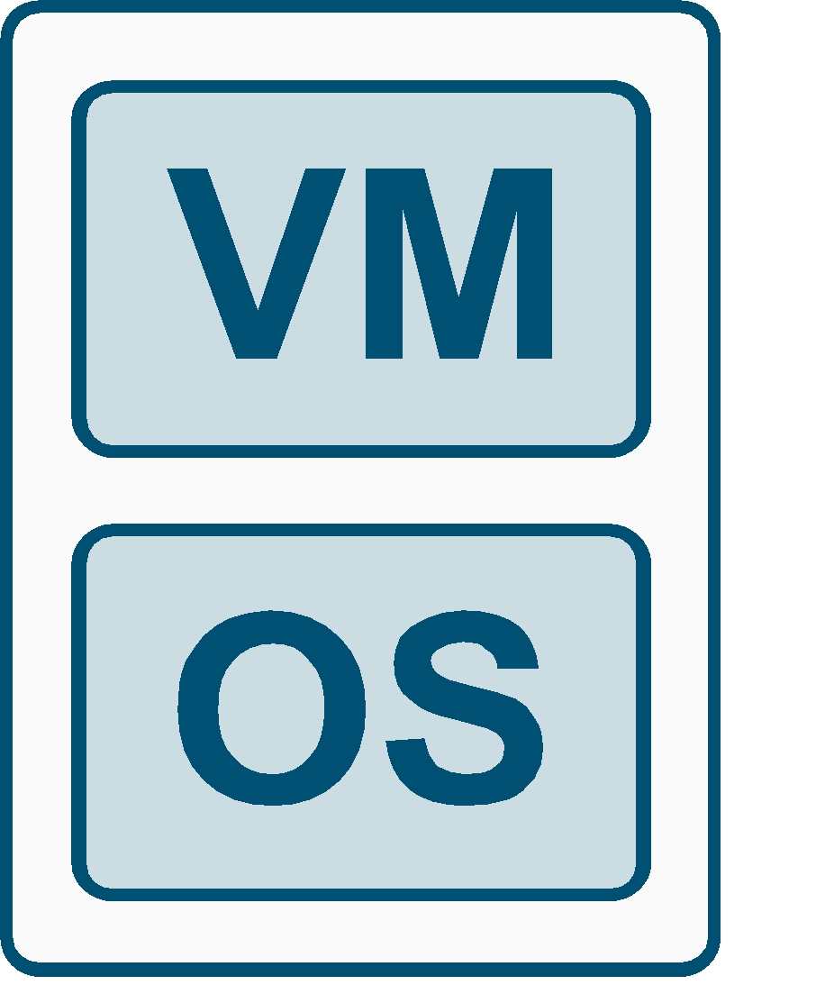


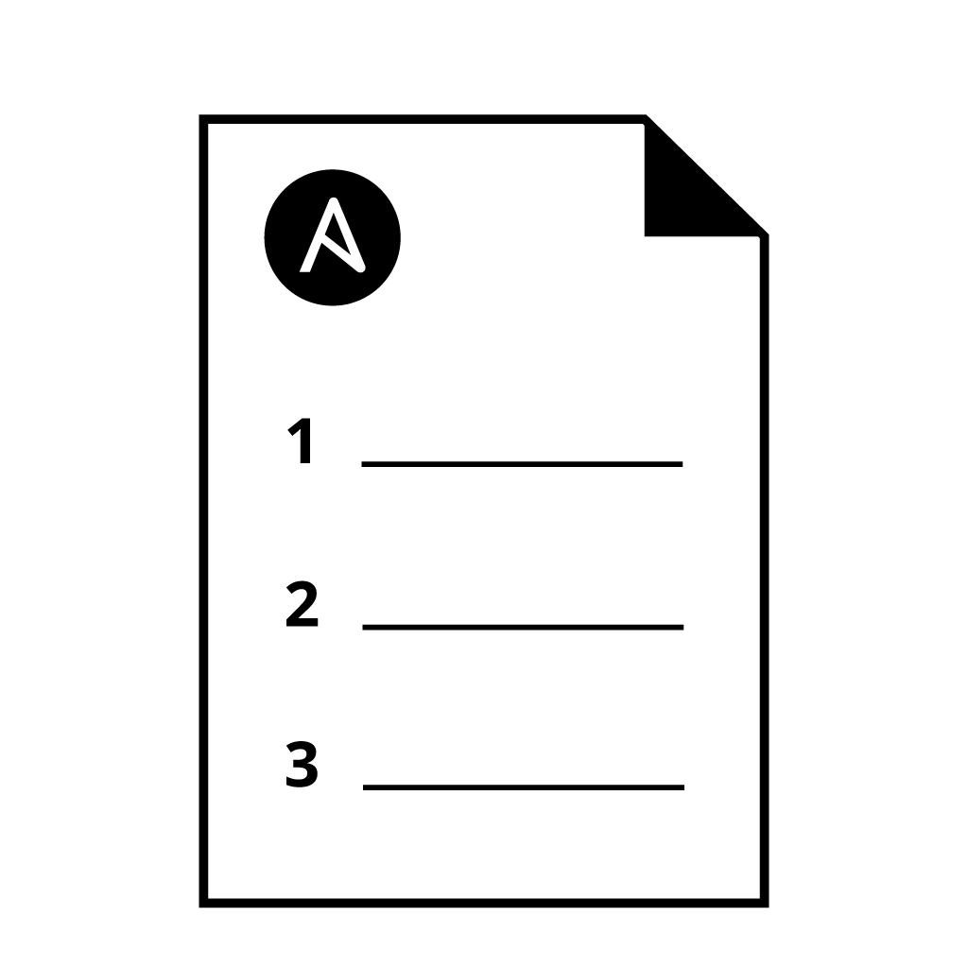



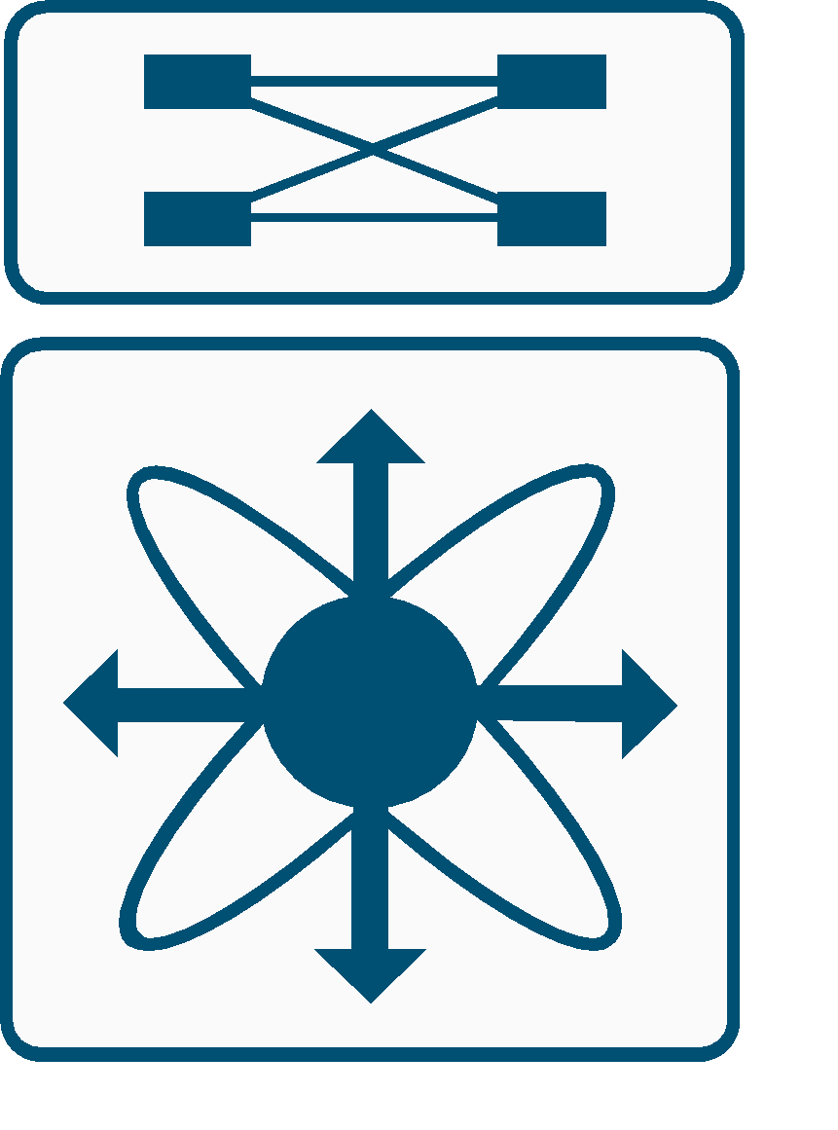
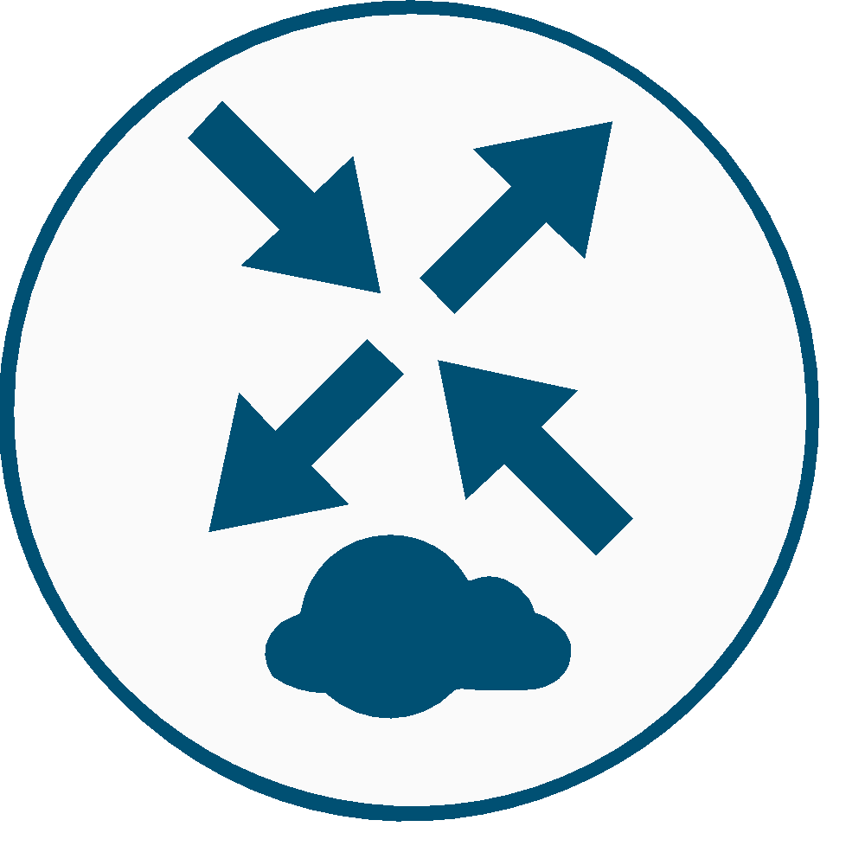
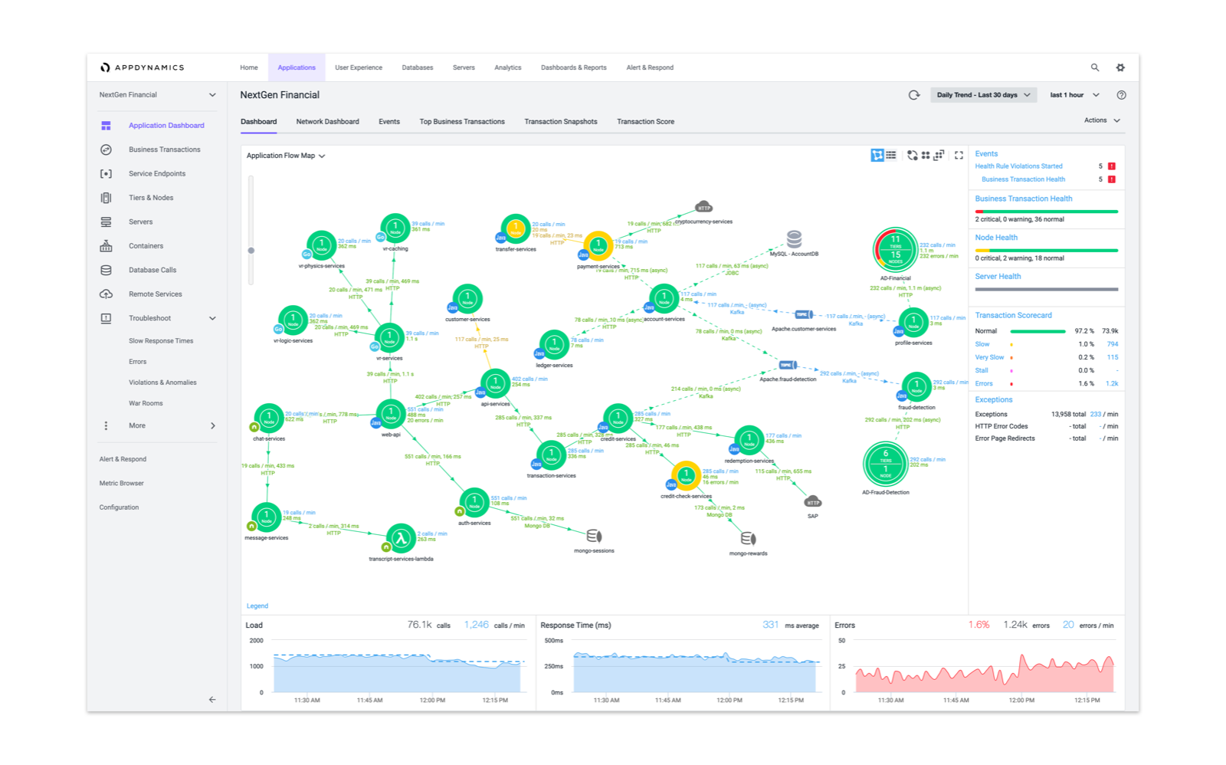
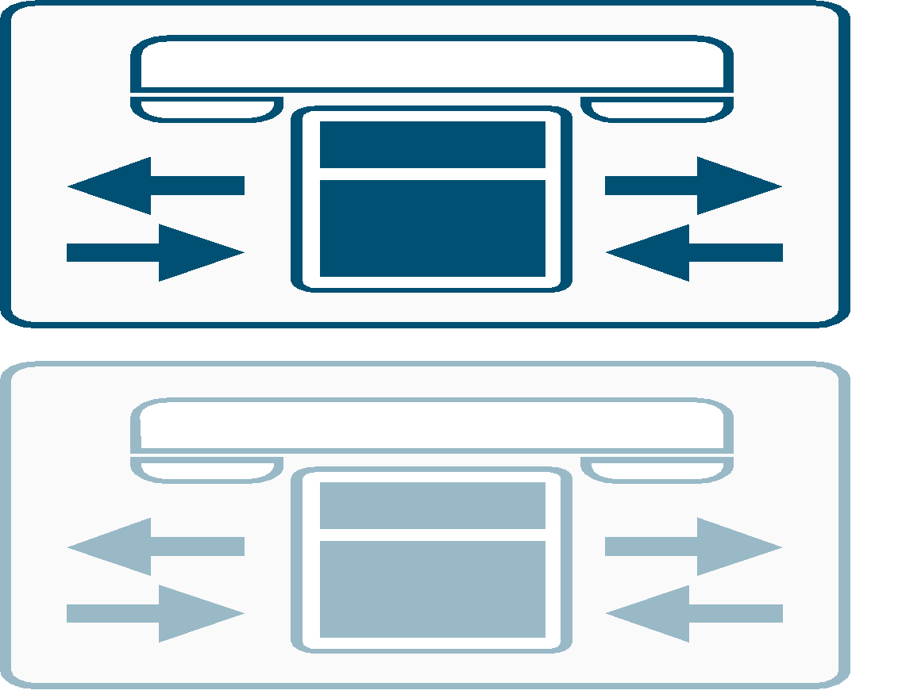
Workflow Management
Viptela
vBond
vManage
vSmart
Ansible Automation Hub Service Catalog
ACI
MDS
ASA 5500
Hypervisor
DEPLOYMENT
Cisco DNA Center
POLICY DEPLOYMENT
IPS/IDS
ANSIBLE PLAYBOOK
UCS / HyperFlex
Nexus 7k
ISE
CSR 1000v
AppDynamics
Communications Manager
Notes:
Automation of business workflows
Containerization of services
Catalog of business services

Slide 31
Automating Cisco Solutions with Ansible – Demo Resources
DNA Center & ACI - demo available - laptop, VirtualBox, Cisco DevNet Always-On Sandbox & GitHub
Intersight – demo in development – laptop, VirtualBox, Cisco DevNet Sandbox (reservation) & GitHub
IPS/IDS, ASA & Tetration - modules and playbooks available, demos to be developed
Umbrella – roadmap
FirePower Next-Gen IPS/IDS
ASA Next-Gen Firewalls
DNA Center
Umbrella
Intersight
vManage
Tetration
Notes:
DNA Center & ACI - demos available - laptop, VirtualBox, Cisco DevNet Always-On Sandbox & GitHub
Insight - demo being developed – laptop, VirtualBox, Cisco DevNet Sandbox Reservation & GitHub
IPS/IDS, ASA & Tetration - modules and playbooks available, demos to be developed
Umbrella – future demo development

Slide 32
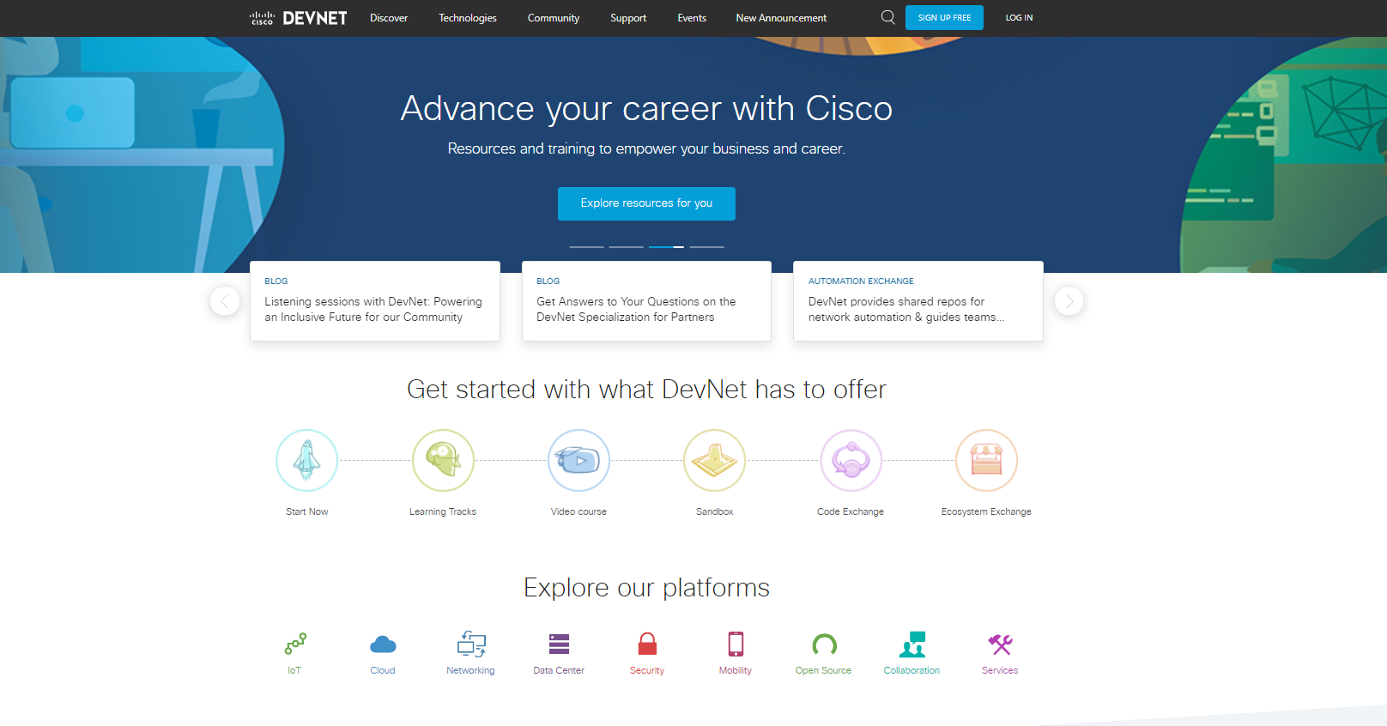
DevNet Resources
https://developer.cisco.com
Notes:
70 DevNet Sandboxes

Slide 33
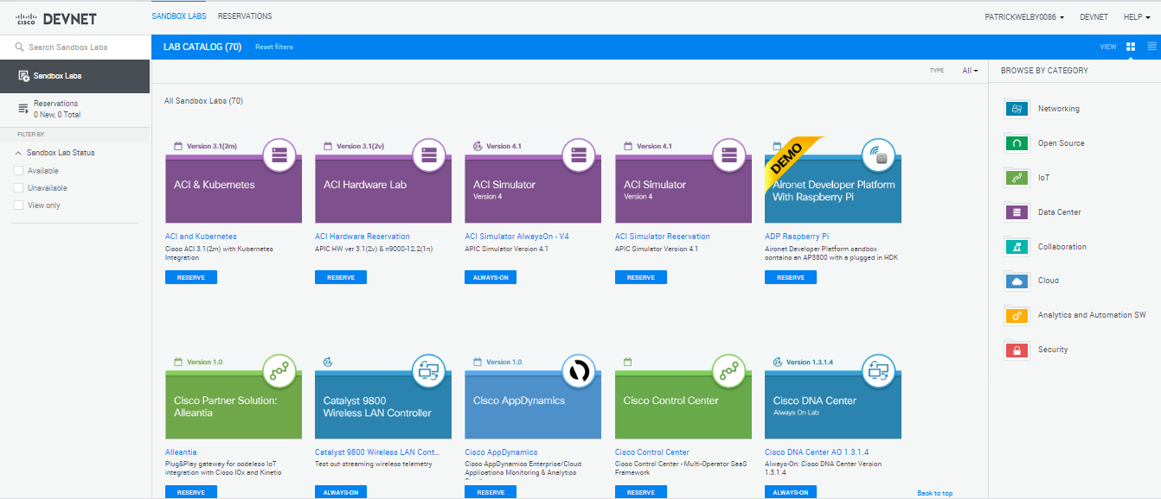
Additional DevNet Sandboxes
70 Sandboxes @ https://devnetsandbox.cisco.com/RM/Topology
Notes:
70 DevNet Sandboxes

Slide 34
Cisco ACI – Red Hat Ansible Solution – Quote from Ravi Balakrishnan, Sr. Product Marketing Manager, Data Center Solutions @ Cisco
“Ansible is the only solution in the market today to address network automation challenges, with its unified configuration, provisioning and application deployment, and creating favorable business outcomes like accelerated DevOps and a simplified IT environment.”
“Ansible brings lots of synergies to an ACI environment with its simple automation language, powerful features such as app-deployment, configuration management, workflow orchestration, and above all an agentless architecture that makes the execution environment predictable and secure.”
https://blogs.cisco.com/datacenter/whats-new-and-exciting-on-cisco-aci-with-red-hat-ansible-collections

Slide 35
Resources
GitHub repository of demonstration
https://github.com/johnwelby1965/cisco_aci.git
Cisco DevNet Code Exchange
https://developer.cisco.com/codeexchange
Red Hat Ansible Automation Platform
https://www.ansible.com/products/automation-platform
Cisco Blog – What’s new and exciting on Cisco ACI with Red Hat Ansible Collections
https://blogs.cisco.com/datacenter/whats-new-and-exciting-on-cisco-aci-with-red-hat-ansible-collections
Cisco DevNet – Cisco with Ansible
https://developer.cisco.com/automation-ansible/

Slide 36
Cisco & Red Hat Joint Enterprise Solutions
Purpose
 | NAME | CATEGORY | Solutions Status
 | ACI+Ansible | Data Center Management | Selling: PowerPoint Solution Development: DevNet Learning Labs/Code Exchange/Always-On Sandbox, dCloud Demo: Available Demo: AWS coming soon
 | DNA Center+Ansible (dynamic inventory source) | Campus Network Management | Selling: PowerPoint Solution Development: Playbook Demo: Available Demo: AWS coming soon
 | Tetration+Ansible | Application Security & Policy Enforcement | Selling: PowerPoint, Cisco Blog Solution Development: Playbook, Cisco DevNet Code Exchange, GitHub, dCloud
 | Intersight+Ansible | Hybrid Cloud Workload Optimizer | Selling: Cisco DevNet Labs & Code Exchange Demo: dCloud or GVE Team (Cisco Sales teams) Solution Development: Coming Soon
Notes:
Using Tetration for Application Security and Policy Enforcement - https://blogs.cisco.com/developer/tetration-for-security
Cisco GVE – Global Virtual Engineering team (can deliver dCloud demos to customers)

Slide 37

Joint Cisco – Red Hat Sales Plays
Ansible + ACI
(better together)
OpenShift + UCS
(better together)
Hybrid Cloud
(VMware takeout)
Use Cases
Simplify Network Operations
Simplify DevOps
Automated hybrid cloud platform
Network
Automation
Complete End to End
container platform
Next Generation Software Defined DC
Technologies
ACI, N9K
Ansible
UCS/HX, N9K, Intersight, Storage
OCP, RHEL,
UCS/HX, N9K
AppD, Intersight, IWO, ACI
Ansible, OCP, Insight, RHEL

Slide 38
Demonstration

Slide 39



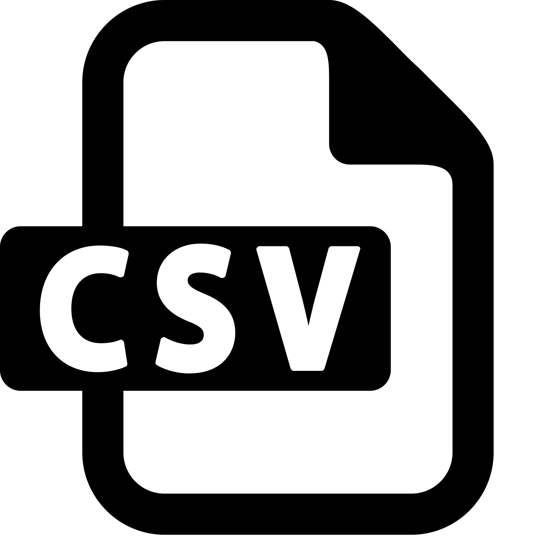




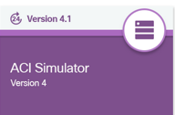

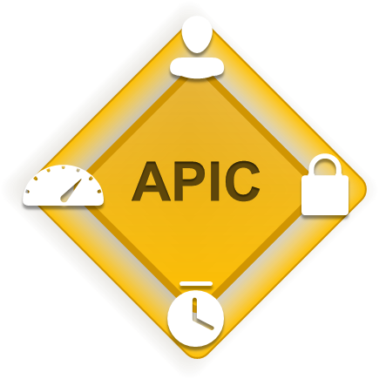
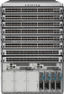
ACI + Ansible + DNA Center – Data Center Modernization
VERSION CONTROL
IPAM
GLOBAL CONFIG YAML
ENCRYPTED CREDENTIALS
SERVICE TICKETING SYSTEM
MongoDB
Cisco DNA Center
ROLES | COLLECTIONS
SOURCE OF TRUTH
INSTALLATION
DEPLOYMENT
APP DEPLOYMENT
NETWORK DEPLOYMENT ENGINEER
ANSIBLE PLAYBOOK
ANSIBLE PLAYBOOK
https://developer.cisco.com/site/aci/
https://github.com/johnwelby1965/cisco_aci.git
https://github.com/johnwelby1965/dnac
Notes:
https://github.com/datacenter/ansible-role-aci-model

Slide 40
Thank you
Red Hat is the world’s leading provider of enterprise open source software solutions. Award-winning support, training, and consulting services make Red Hat a trusted adviser to the Fortune 500.

Slide 41
For Additional Information or Demo Requests, Contact a Red Hat / Cisco Alliance Team Member

Slide 42
Appendix A
Ansible vs. Terraform

Slide 43
Orchestration vs. Configuration Management
Orchestration tools have one goal: to ensure an environment is continuously in its ‘desired state.’
Configuration management tools are different; they don’t reset a system. Instead, they locally repair an issue.
A CM tool works to repair a problem instead of replacing the system entirely.

Slide 44
Ansible vs. Terraform
Terraform is an orchestration tool. Ansible is mainly a configuration management tool.
Terraform is built for orchestration as it stores the state of the environment, and when something does not function properly, it automatically computes and restores the system after reloading.
Ansible and Terraform perform differently but do have some overlaps since these functions are not mutually exclusive.
Ansible also can configure each action and instrument and ensure its functioning correctly without any error or damage.
Ansible is a bit of a hybrid since it can do both, perform orchestration and replace infrastructure.
Terraform has advanced state management capabilities, which Ansible does not.

Slide 45
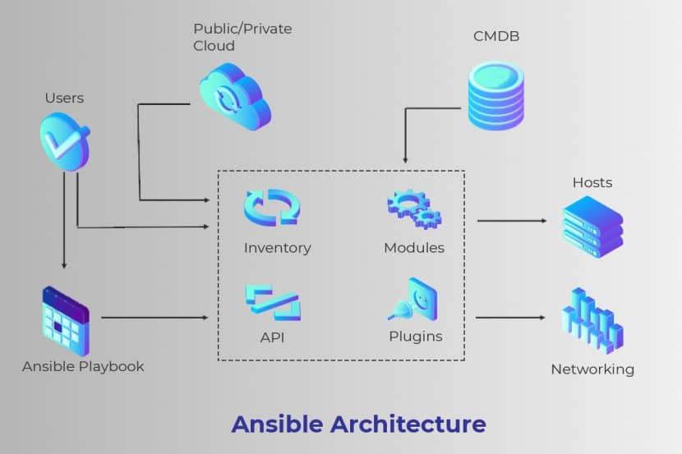
Provisioning with Ansible
Ansible can provision the latest cloud platforms,
network devices, bare metal servers, virtualized
hosts, and hypervisors reliably.
After completing bootstrapping, Ansible allows
separate teams to connect nodes to the storage.
Ansible can add them to a load balancer, or any security patched or other operational tasks. This setup makes Ansible the perfect connecting tool for any process pipeline.
Ansible aids in automatically taking bare infrastructure right through to daily management.
Provisioning with Ansible, allows users to use a universal, human-readable automation language seamlessly across configuration management, application deployment, and orchestration.

Slide 46
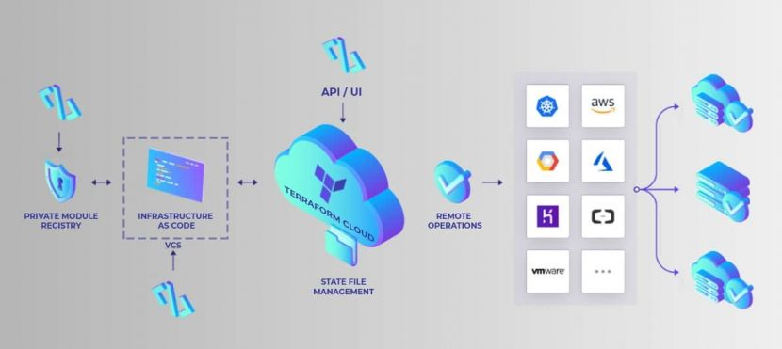
Provisioning with Ansible
There are certain behaviors not represented in
Terraform’s existing declarative model. This
setup adds a significant amount of uncertainty
and complexity when using Terraform in the
following ways:
The Terraform model is unable to model the actions of provisioners when it is part of a plan. It requires coordinating more details than what is necessary for normal Terraform usage to use provisioners successfully.
Terraform requires additional measures such as granting direct network access to the user’s servers, installing essential external software, and issuing Terraform credentials for logging in.

Slide 47
Comparison of Ansible, Puppet, and Terraform
Ansible / Puppet / Terraform
 | Source | Cloud | Type | Infrastructure | Language | Agent | Master | Community | Maturity
Puppet | Open | All | Config Mgmt | Mutable | Declarative | Yes | Yes | Large | High
Ansible | Open | All | Config Mgmt | Mutable | Procedural | No | No | Huge | Medium
Terraform | Open | All | Config Mgmt | Mutable | Declarative | No | No | Huge | Low

Slide 48
Appendix B
Cisco Modeling Labs

Slide 49
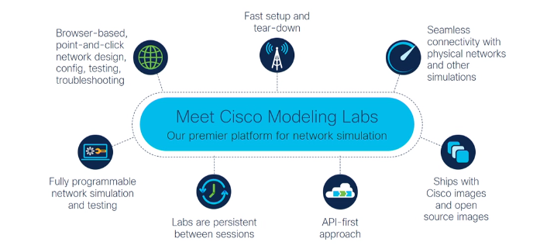
Cisco Modeling Labs
Notes:
Meraki is cloud-based but should be able to run in CML
DNA-C & SD-Access – now, use External Connections. Future releases will integrate both.
ACI – use ACI simulator for now.
External Network Connectivity Options: (1) NAT (2) L2 or Bridge – share one physical NIC to VMs in CML

Slide 50
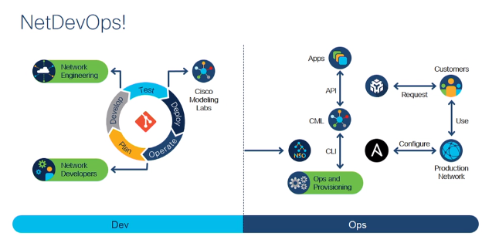
Cisco Modeling Labs
Notes:
CML is at the center of the CI/CD tool chain.
Use NSO, Ansible, PyATS to configure production network to eliminate human error.
Under the covers, CML uses Linux networking.
Don’t mess with base network adapter, “bridge0” which is used for management.
Add a 2nd interface – Trunk – VLAN 4095 (send all vlans)
CentOS Linux Cockpit
Networking
Interfaces automatically show up
Can add vlans
Add bridge interfaces

Slide 51
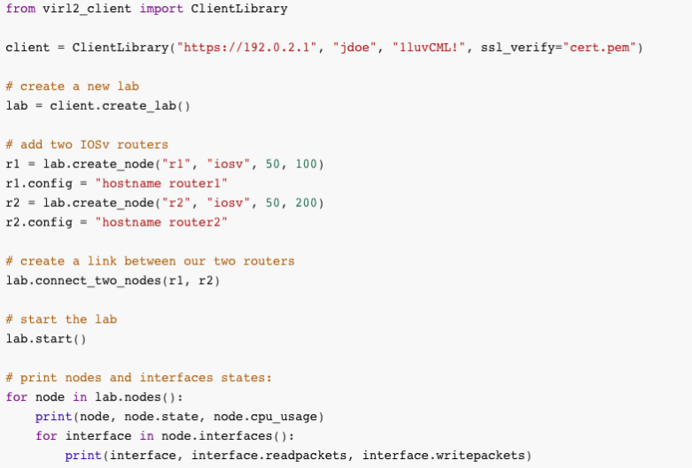
Cisco Modeling Labs – Ansible Module to Automate Lab Creation and Operation
https://github.com/CiscoDevNet/ansible-virl
https://blogs.cisco.com/developer/automation-with-cml2 (Joe Clarke, Cisco Distinguished Engineer)
Notes:
CML is at the center of the CI/CD tool chain.
Use NSO, Ansible, PyATS to configure production network to eliminate human error.
Under the covers, CML uses Linux networking.
Don’t mess with base network adapter, “bridge0” which is used for management.
Add a 2nd interface – Trunk – VLAN 4095 (send all vlans)
CentOS Linux Cockpit
Networking
Interfaces automatically show up
Can add vlans
Add bridge interfaces

Slide 52
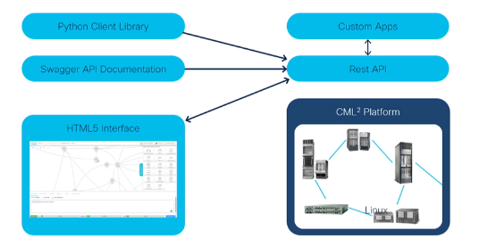
Cisco Modeling Labs - Architecture

Slide 53
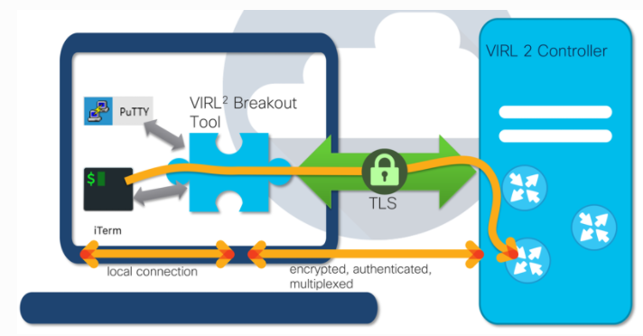
Cisco Modeling Labs – Breakout Tool
Notes:
Use the Breakout Tool to map devices to any port on your underlying CML server
Use External Connectors to attach CML lab to a physical network
Use the Open Source cmlutils app to easily access devices from outside CML
CML Community – GitHub contains node definitions for SD-WAN controllers
DNA Center
Fusion routers interacting with DNA-C fabric
A Fusion device enables Virtual routing and forwarding (VRF) leaking across SD-Access Fabric domains, and enables host connectivity to shared services, such as DHCP, DNS, NTP, ISE, Cisco DNA Center, Wireless LAN Controllers (WLC) and similar.

Slide 54
Cisco Modeling Labs – Infrastructure as Code
Ansible Inventory Generation & Add/Update NSO with CML simulation
cml generate ansible

Slide 55
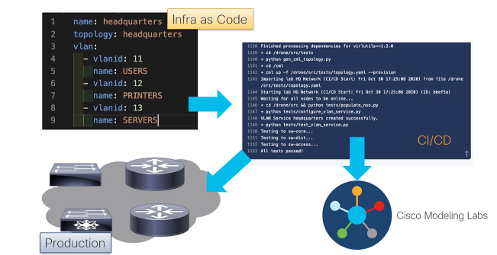
Cisco Modeling Labs – Infrastructure as Code
Create a Service in YAML
Test/Verify using PyATS (JSON output)
Deploy into production
Note: CML does not have a physical chassis nor the data plane, therefore troubleshooting is limited in this regard.
Notes:
PyATS was originally developed for internal Cisco engineering use, pyATS is at the core of Cisco's Test Automation Solution.
It's currently used:
as the de-facto test framework for internal Cisco engineers across different
platform/functions, running millions of CI/CD, sanity, regression, scale,
HA, solution... tests on a monthly basis.
by thousands of network engineers and developers world-wide, outside of Cisco.
In Cisco, pyATS provides sanity, feature, solution,
system, and scale test & verification automation for products
ranging from routers/switches, to access points, firewalls and cable CPEs.

Slide 56
Cisco Modeling Labs – Pipeline Steps using Drone or GitLabs CI
Requirements install
Configure NSO
Start NSO
Use cmlutils to generate topology file
Wait for nodes to come up
Deploy¹ configuration – translate YAML to IOS/IOSXE/IOSXR, etc
¹ Deploy into CML exactly the same way you deploy to your production network.

Slide 57
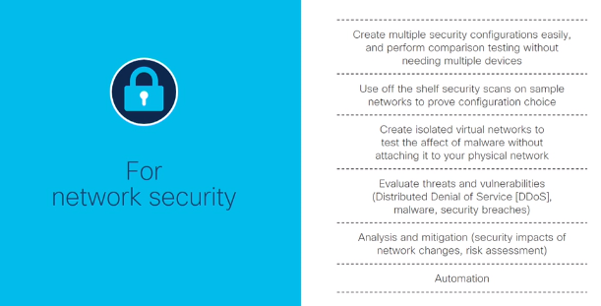
Cisco Modeling Labs
Use Case: Threat & Vulnerability Evaluation

Slide 58
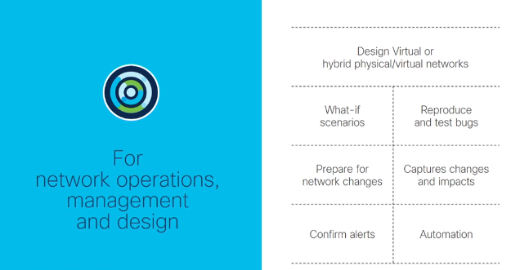
Cisco Modeling Labs
Use Case: Network Design / Prepare for Network Changes

Slide 59
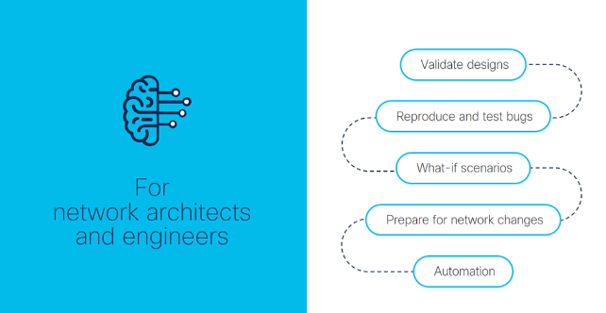
Cisco Modeling Labs
Use Case: Design Validation & Reproduce Bugs

Slide 60
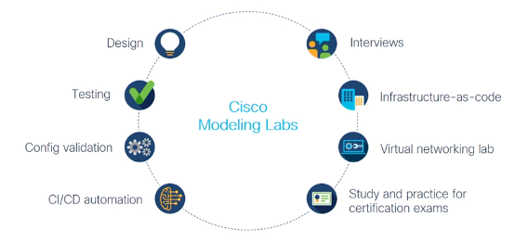
Cisco Modeling Labs

